Slide 1
LIVE DEMO · AGENTIC AI CAPSTONE
Treasury, Liquidity &
Intraday Cash Management Agent
5
The problem: Treasury teams need faster visibility into cash, settlement, and funding risk before small gaps become urgent issues.
AI agents orchestrated
$500K
shortfall forecast, live
2 hrs
advance warning
Presenter Name · August 6, 2026
Notes:
30 seconds — introduce the project and the problem it solves for treasury teams.

Slide 2
WHAT IT DOES
Six capabilities, one liquidity workflow
1
Cash Position Monitoring
2
Liquidity Forecasting
Tracks acct-001–004 balances; nostro totals $3.9M USD / €1.8M EUR / £960K GBP in one view.
Flagged a $500K USD shortfall on acct-001 about 120 minutes before the breach window.
3
Funding Recommendations
4
Threshold Alerting
Selected an Intraday Credit Line to cover the projected $500K gap.
Raised 2 live alerts: a funding-gap breach on acct-002 and a repo-rate spread breach.
5
Governance Commentary
6
Stress Simulation
Generates a governance-ready summary — and safely fell back to a verified template when the AI draft didn't pass its own check.
A delayed-settlement scenario stretched the breach window from 120 to 180 minutes.
Treasury, Liquidity & Intraday Cash Management Agent
2 / 5
Notes:
1 minute — walk through each of the six capabilities, calling out the real figures.

Slide 3
HOW IT WORKS
A five-agent pipeline behind every liquidity check
1
2
3
4
5
Data Aggregator
Forecaster
Funding Advisor
Alert Watcher
Report Writer
→
→
→
→
cash_position_agent
forecasting_agent
funding_recommendation_agent
alerting_agent
commentary_agent
Combines balances, funding gaps, collateral, and settlement timing into one snapshot.
Projects the liquidity shortfall for acct-001 and explains the $500K gap.
Recommends an Intraday Credit Line for the projected shortfall.
Raises alerts for the funding gap and the repo-rate spread breach.
Drafts a governance-ready summary for the daily call.
Safety design: the system double-checks its own written summary before showing it. When the AI-written commentary couldn't be verified against the underlying numbers, it automatically fell back to a safe, data-accurate summary — exercised live in this run, not just described.
Treasury, Liquidity & Intraday Cash Management Agent
3 / 5
Notes:
1 minute — explain the five-agent pipeline and the guardrail fallback as a feature, not a flaw.

Slide 4
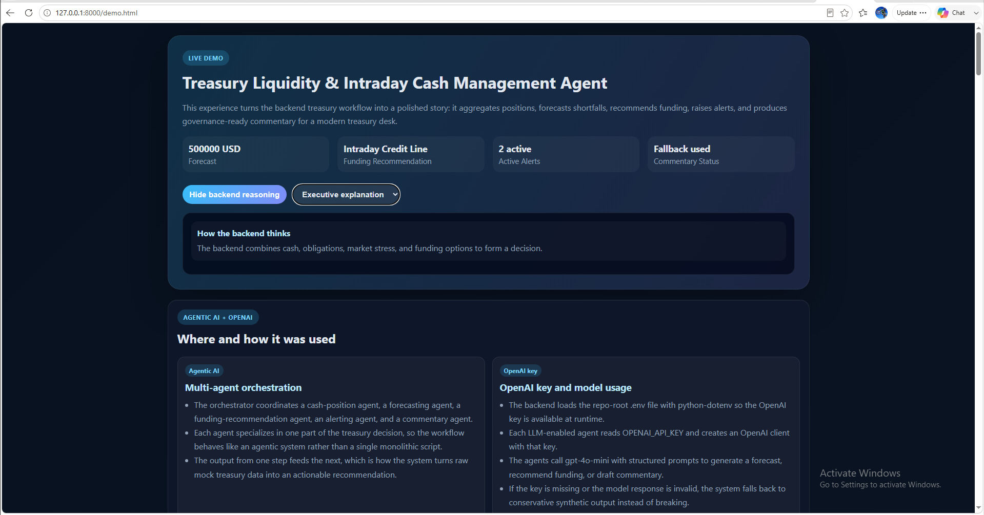
LIVE OUTPUT
What the live run actually produced
FORECAST
$500,000 USD shortfall, acct-001 — est. 120 min to breach
FUNDING ACTION
Intraday Credit Line, $500,000 USD
ACTIVE ALERTS
2 — funding-gap (acct-002), repo-rate spread
COMMENTARY
Safe fallback shown (AI draft failed its own check)
Stress test: a 2-hour delayed-settlement scenario kept the shortfall at $500K but pushed the breach window to 180 minutes.
Actual demo.html output — 127.0.0.1:8000
All figures shown are from synthetic/mock demo data — not live bank or market feeds.
4 / 5
Notes:
2 minutes — walk the audience through the actual live output on screen; this is the core demo moment.

Slide 5
IMPACT & NEXT STEPS
Where this helps — and where it goes next
IMPACT
NEXT STEPS
✓
Speeds response to intraday funding and settlement risk by turning scattered signals into one decision-ready view.
1
Connect the demo to real bank and market data sources.
2
Expand the stress-scenario library beyond delayed settlement and repo-rate stress.
✓
Makes risk testing visible so treasury teams can explore what-if scenarios before a shortfall becomes urgent.
3
Tighten the commentary check so fewer runs fall back to the safe summary.
Built as a time-boxed agentic AI capstone — 5 orchestrated agents, structured JSON outputs, guardrailed commentary, and a live stress-test simulation.
Treasury, Liquidity & Intraday Cash Management Agent
5 / 5
Notes:
30 seconds — close on impact and be candid about realistic next steps.

